Slide 1
Face Recognition and Human Tracking Robot
A Simulation Project using Python, OpenCV, and Computer Vision
Internship: AENEXZ Internship
Team Members:
Arup Pattnaik
Gowri Bhat
Momina

Slide 2
Project Objective
To simulate a robot that detects and tracks human faces using computer vision.
The robot makes real-time decisions like Turn Left, Turn Right, or Move Forward based on the person’s position.
Demonstrates the integration of Artificial Intelligence and Robotics without using physical hardware.

Slide 3



System Overview
Working Flow
Explanation
Camera → Face Detection → Face Recognition → Tracking Logic → Movement Decision → Display Output
The camera captures live video frames. The system detects human faces. Recognized faces are compared with known encodings. The tracking logic calculates position and decides direction.

Slide 4
Team Responsibilities
Member | Module | Role
Anup | Face Recognition | Detect and identify faces using face_recognition library
Gowri | Tracking Logic | Decide robot’s direction (Left/Right/Forward) using OpenCV
Momina | Integration & Report | Combine both modules, test simulation, and prepare final report

Slide 5






Tools & Libraries Used
Language & Libraries
Environment
Platform
IDE
VS Code
Input
Laptop Webcam
Python 3.8+
OpenCV (video capture)
face_recognition (detection)
NumPy (processing)

Slide 6

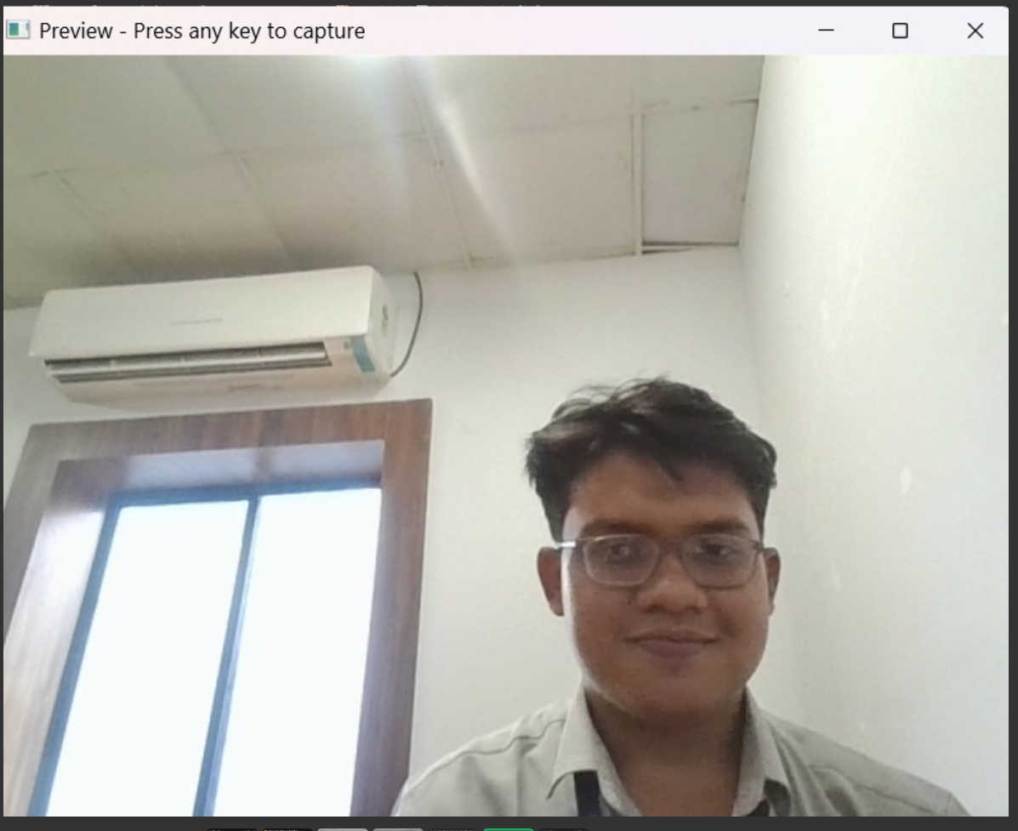
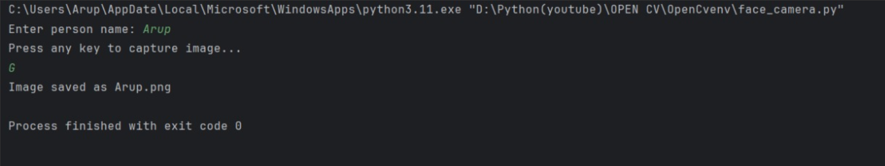
Module 1: Face Recognition
OUTPUT:
Goal & Process
Goal: Detect and identify human faces in real-time using the webcam.
1.
Capture live frames from webcam.
2.
Use face_recognition to detect and encode faces.
3.
Match detected faces with stored known faces.
4.
Label recognized faces with names on screen.

Slide 7

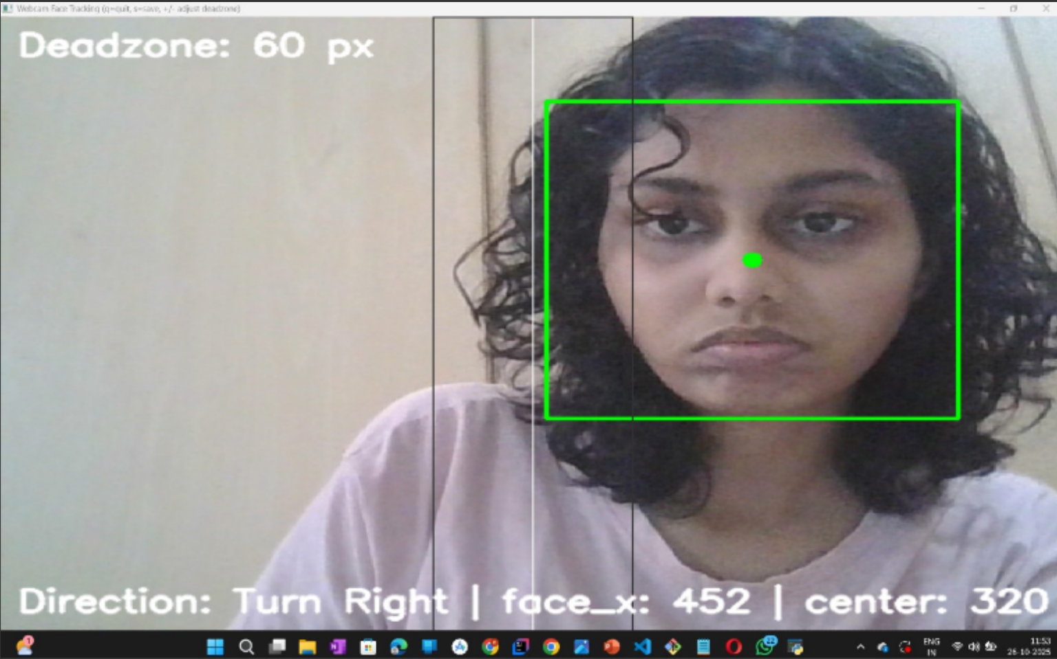
Module 2: Tracking Simulation
Output:
Goal & Concept
Goal: Decide the robot’s direction based on the horizontal position of the detected face.
If face is to the left → Turn Left
If face is to the right → Turn Right
If face is in the center → Move Forward

Slide 8
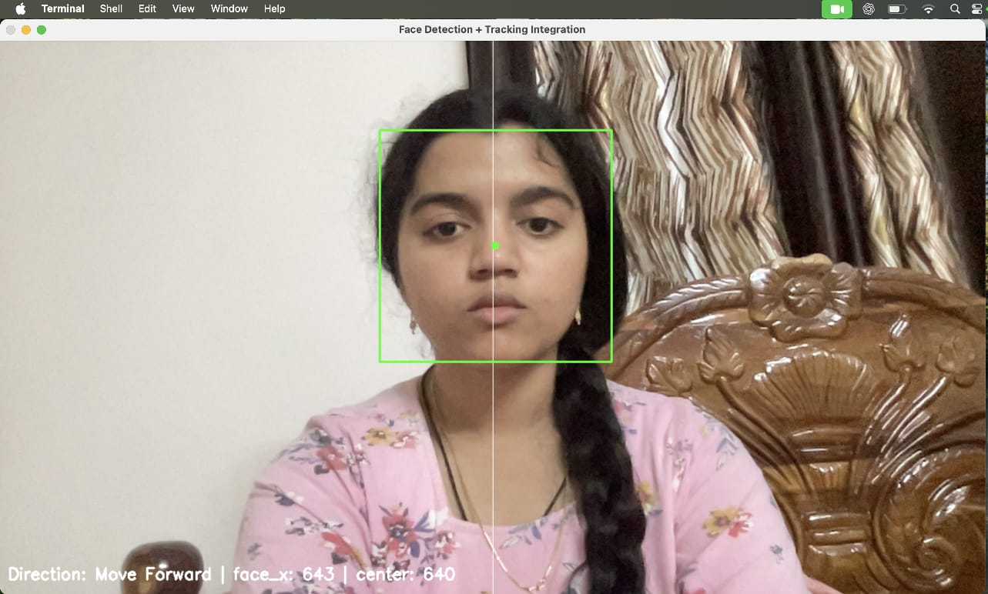
Module 3: Integration & Final Output
Goal: Combine both modules (Face Recognition + Tracking Logic) into one integrated simulation.
Working: Webcam captures live frames.
Face is detected and recognized.
Robot logic decides direction and displays it on screen.
Output:

Slide 9
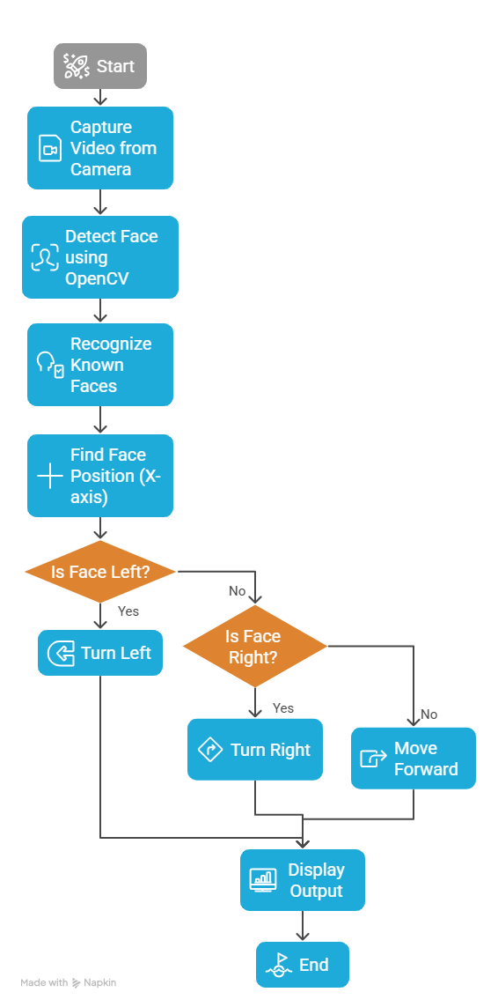
Working Flowchart

Slide 10
Implementation Steps
Set up Python environment.
Implement face detection using OpenCV.
Train and store known faces.
Write tracking logic for direction decision.
Integrate both modules.
Record demo video for results.

Slide 11






Module Highlights
Face Recognition
Tracking Simulation
Final Integration
Successfully detected and identified known faces in real-time from the webcam feed.
Both modules were successfully combined into a single, responsive simulation application.
Accurately decided 'Turn Left', 'Turn Right', or 'Move Forward' based on face's X-coordinate.

Slide 12
Results and Observations
Successfully simulated a real-time human-tracking robot using only software.
The system detects and tracks faces instantly.
Smooth and accurate decision-making logic.
Collaboration between team members ensured clear division of modules.

Slide 13
Future Scope
Integrate the simulation with Raspberry Pi and DC motors for real movement.
Add ultrasonic sensors for obstacle detection.
Add emotion recognition and voice response for interaction.
Develop a mobile app to control and monitor the robot remotely.

Slide 14
Conclusion
The project demonstrates how AI and robotics can be integrated to build intelligent systems.
Achieved complete real-time face detection, recognition, and tracking simulation.
The same code can be easily adapted for real robots.

